Slide 1
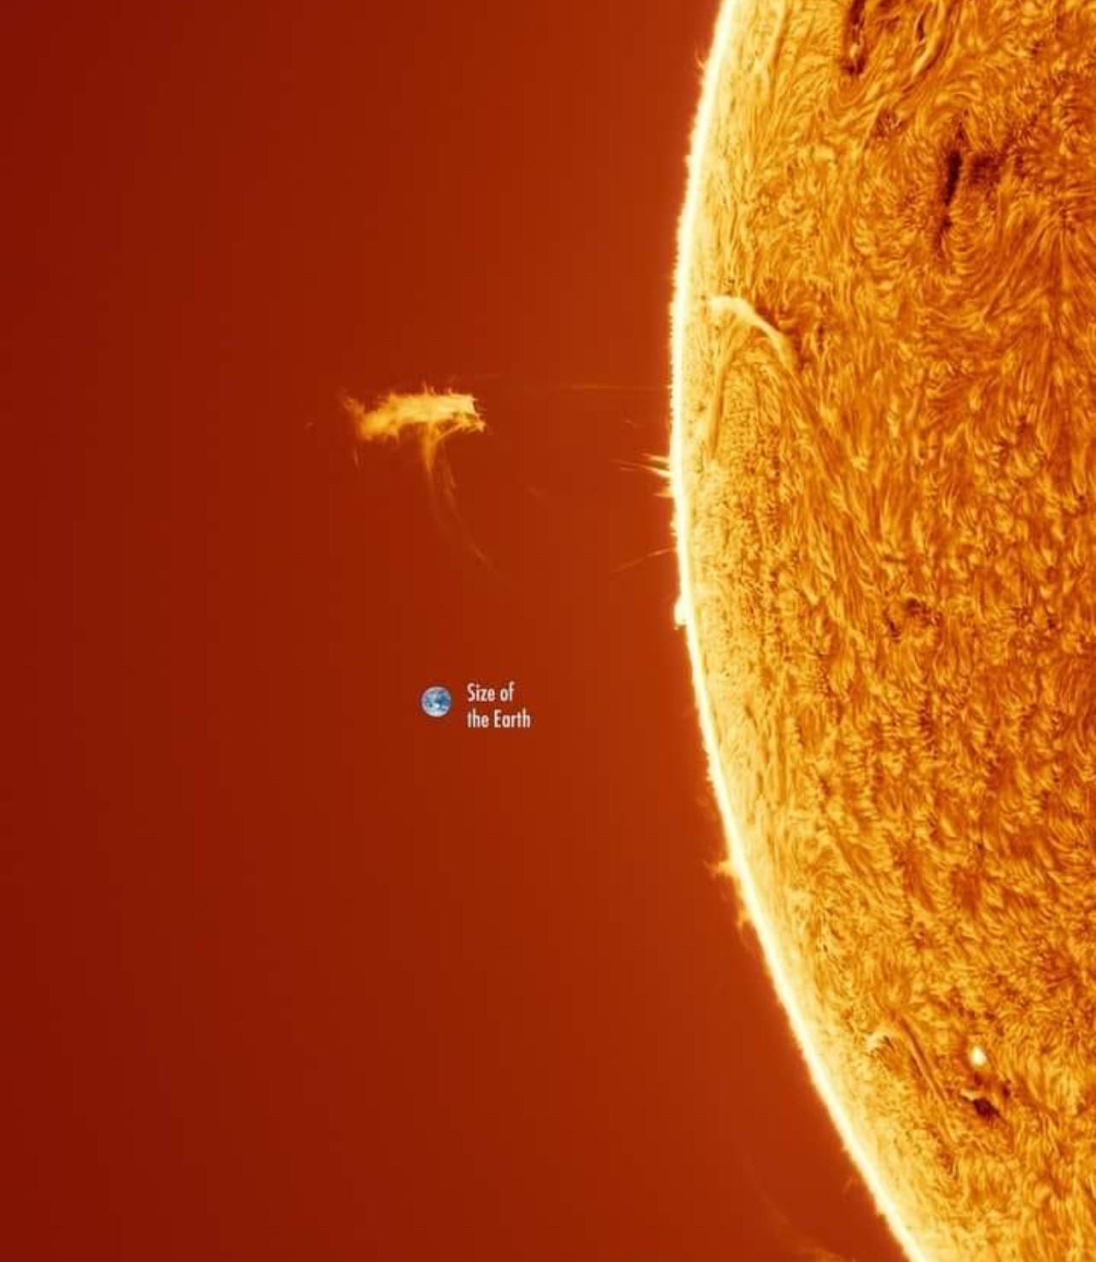
Remote
Sensing
Lt Col Miller
Notes:
Quickbird

Slide 2
Remote Sensing
Broader view of remote sensing
Understand resolution better
Know some real-world systems
Requirements
Subject
Wavelength
Coverage Area
Gaps
Revisit

Slide 3
Remote Sensing
Detecting and monitoring the physical characteristics of an area by measuring its reflected and emitted radiation at a distance
Satellite & Aircraft imaging
LiDar, Radar, Thermal
Sonar

Slide 4
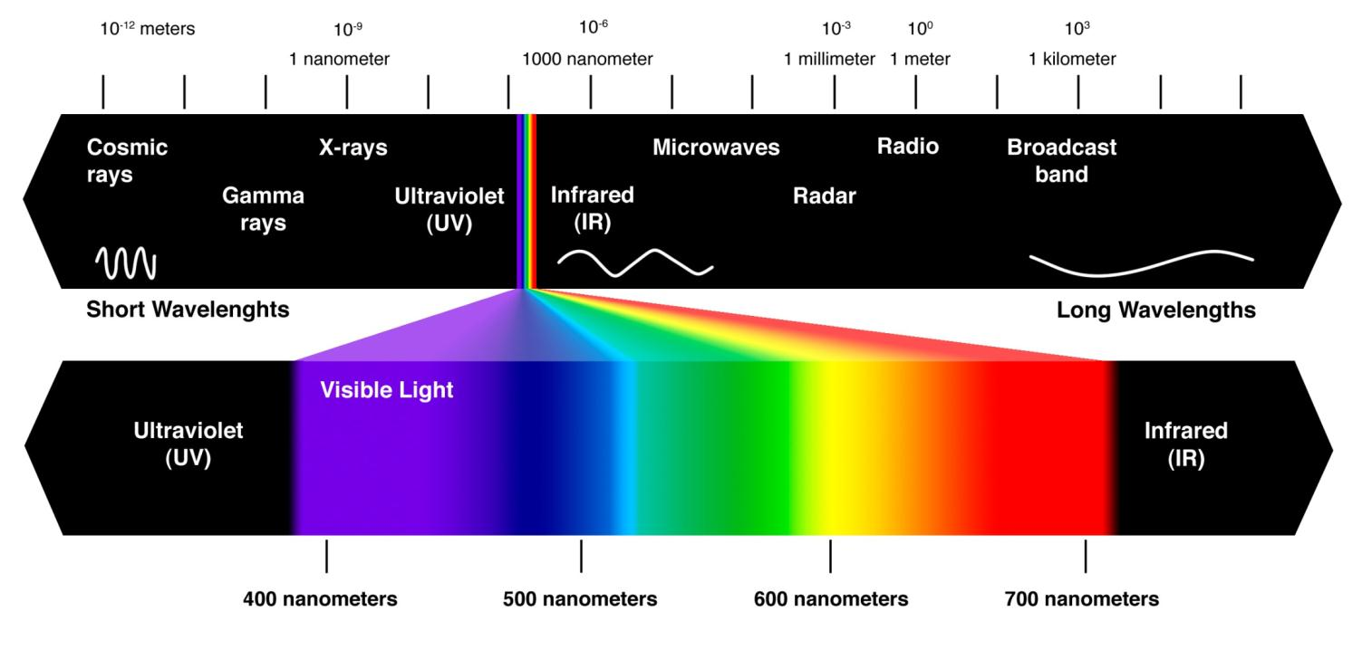
Electromagnetic Spectrum

Slide 5
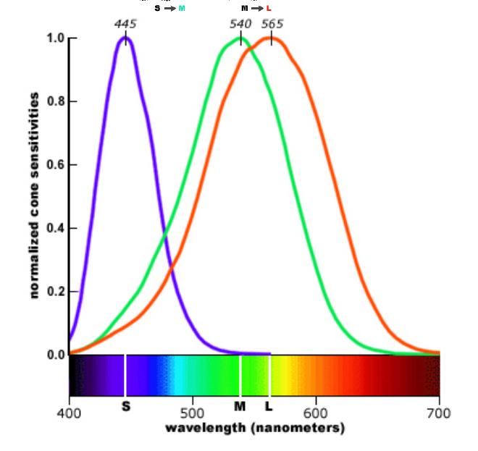

Slide 6
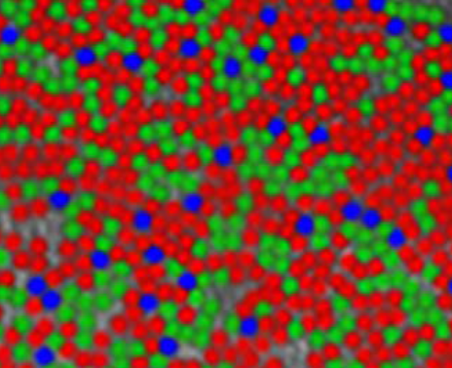
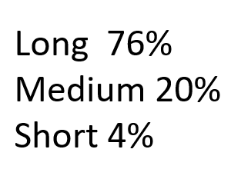

Slide 7
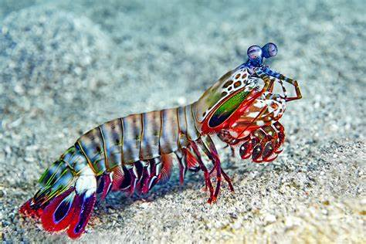
Electromagnetic Spectrum

Slide 8
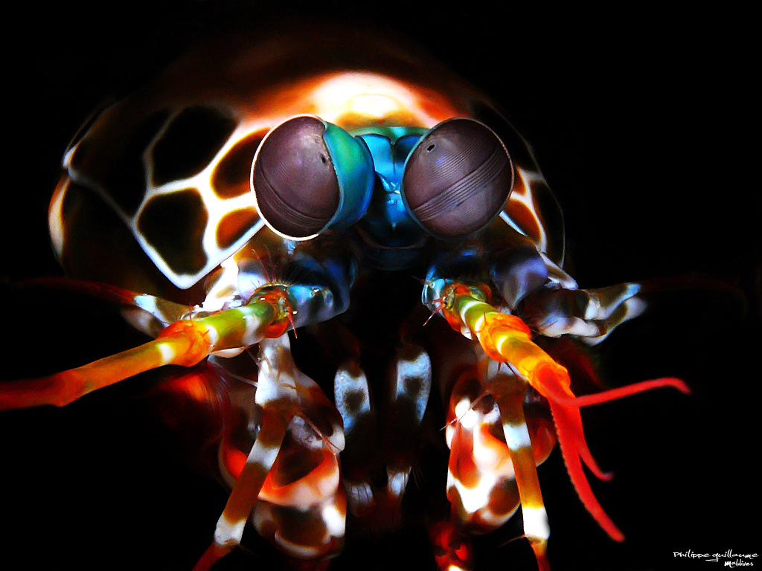
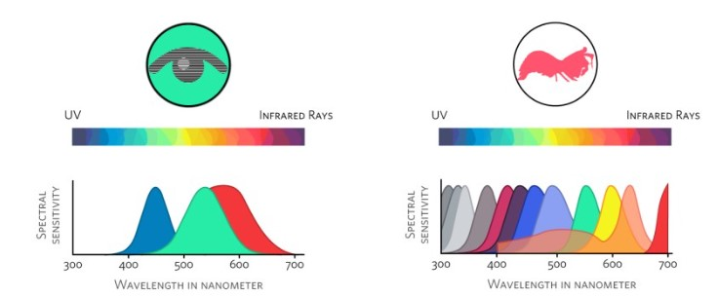

Slide 9
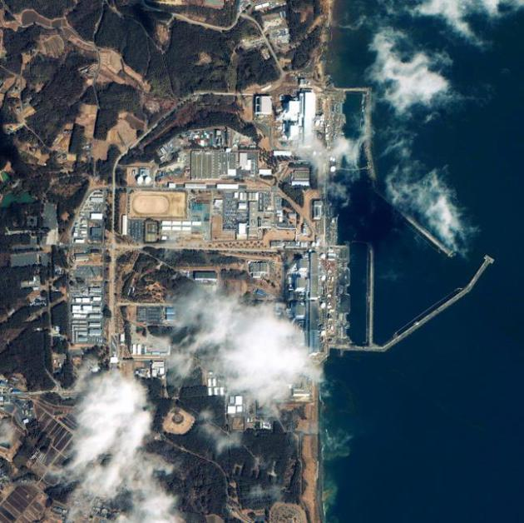
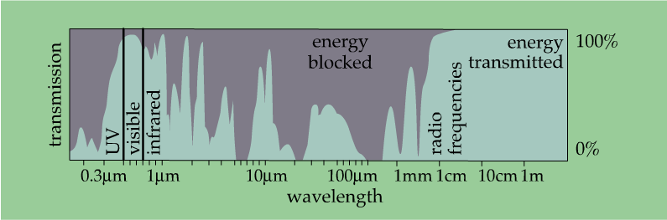
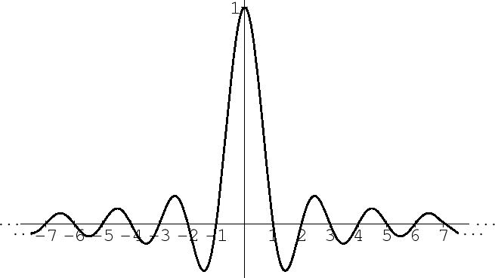

Slide 10
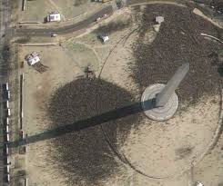
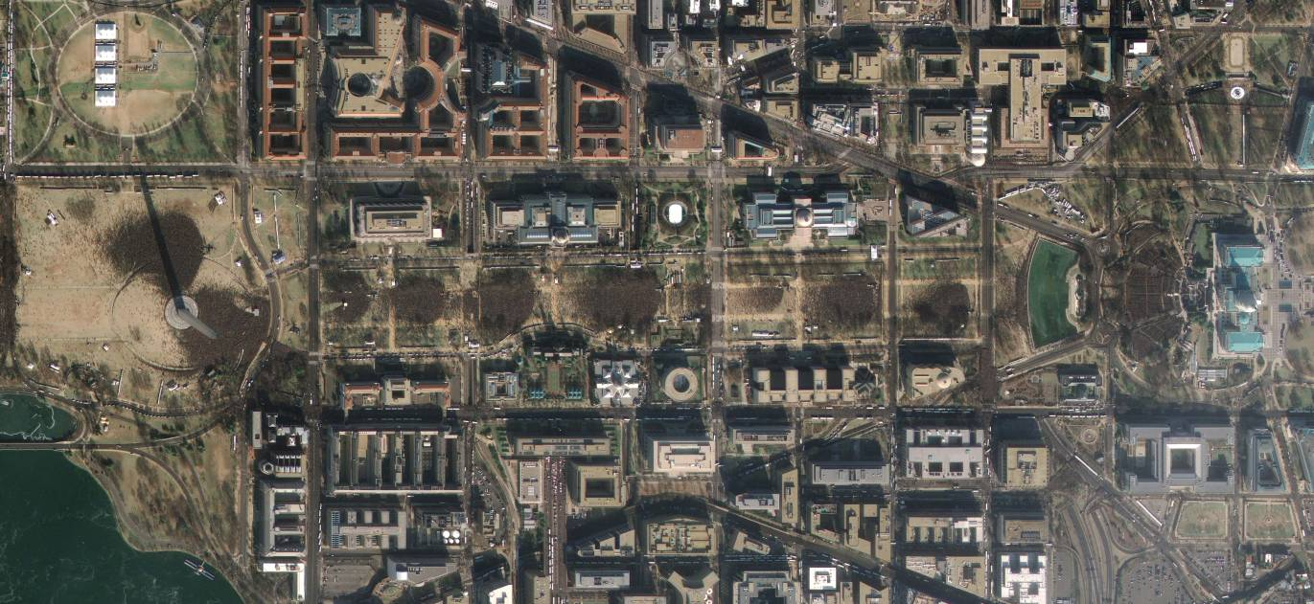

Slide 11
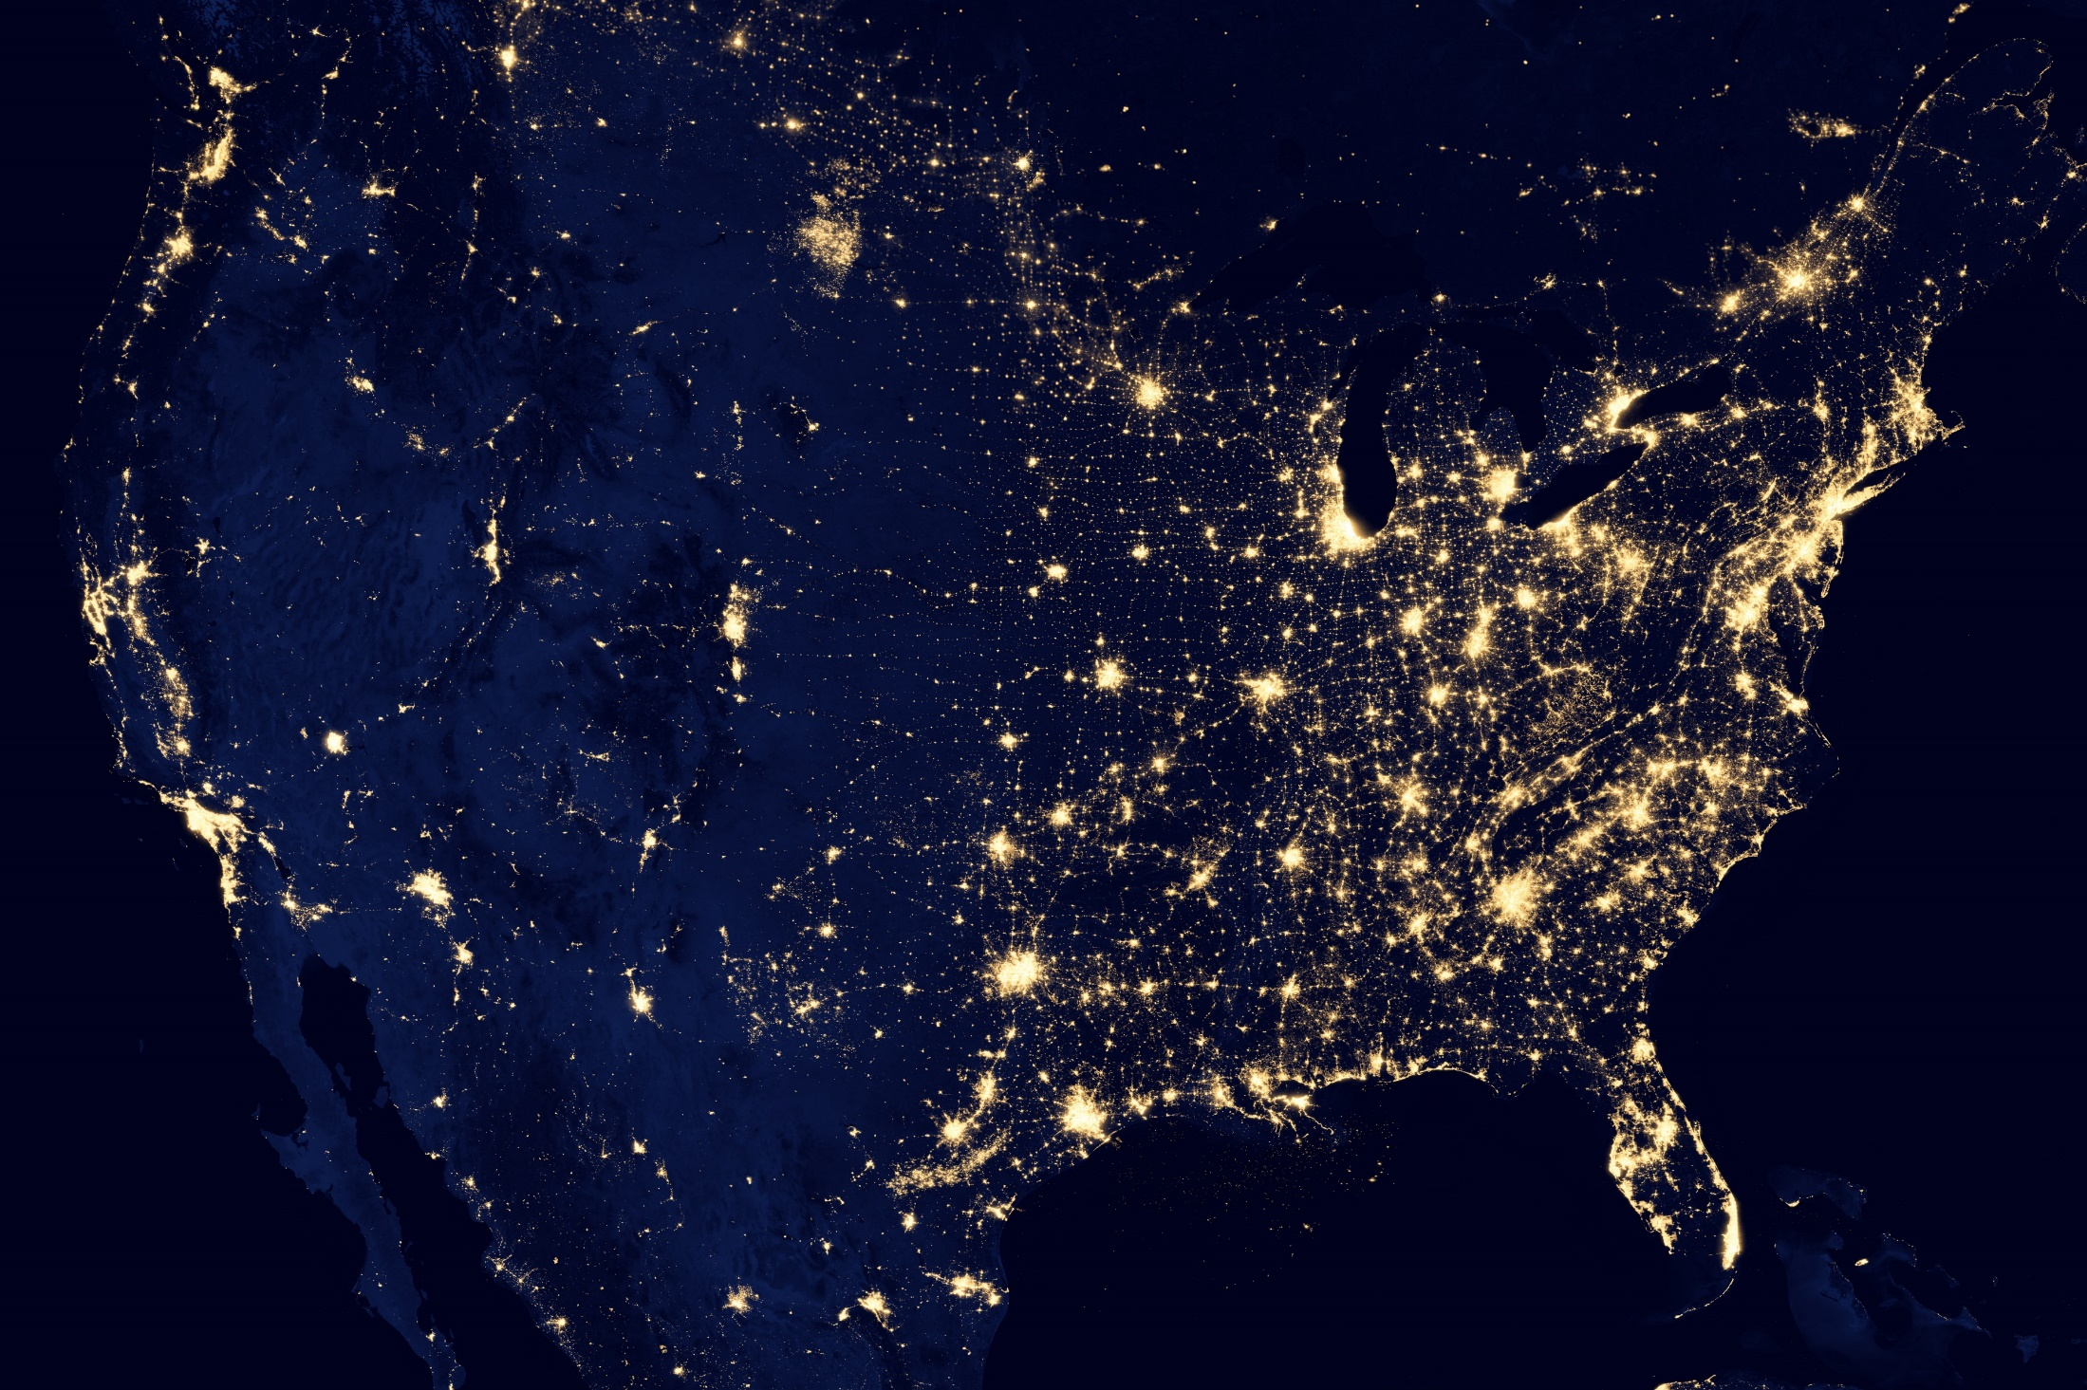
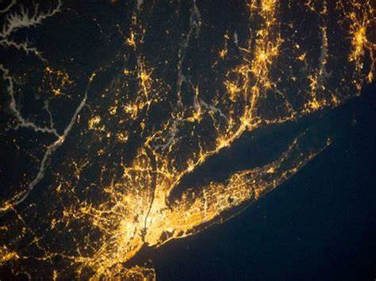

Slide 12
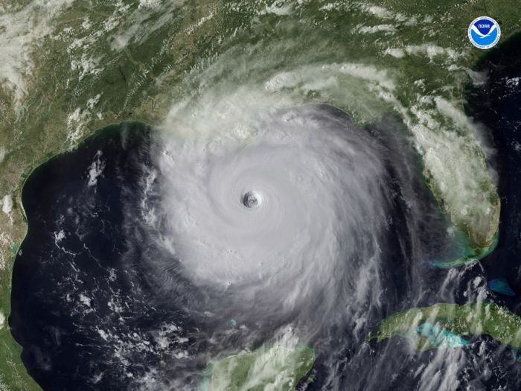

Slide 13
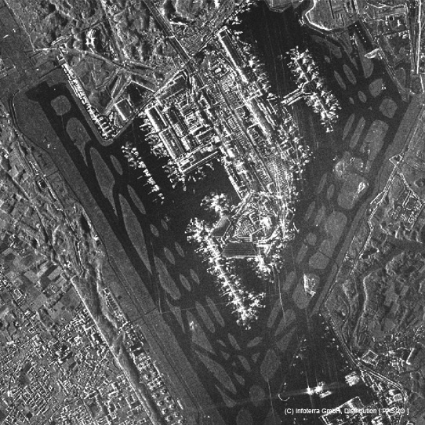
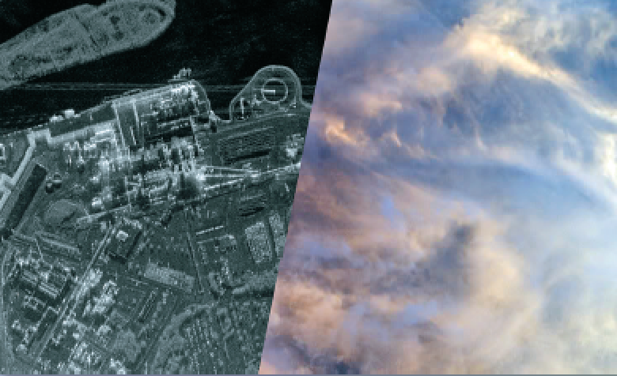
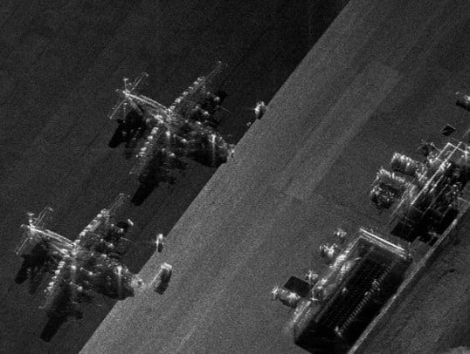
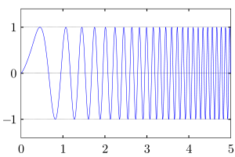
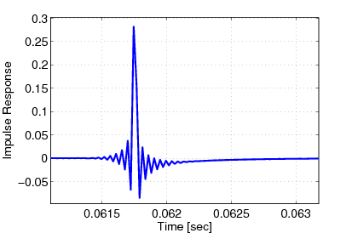

Slide 15
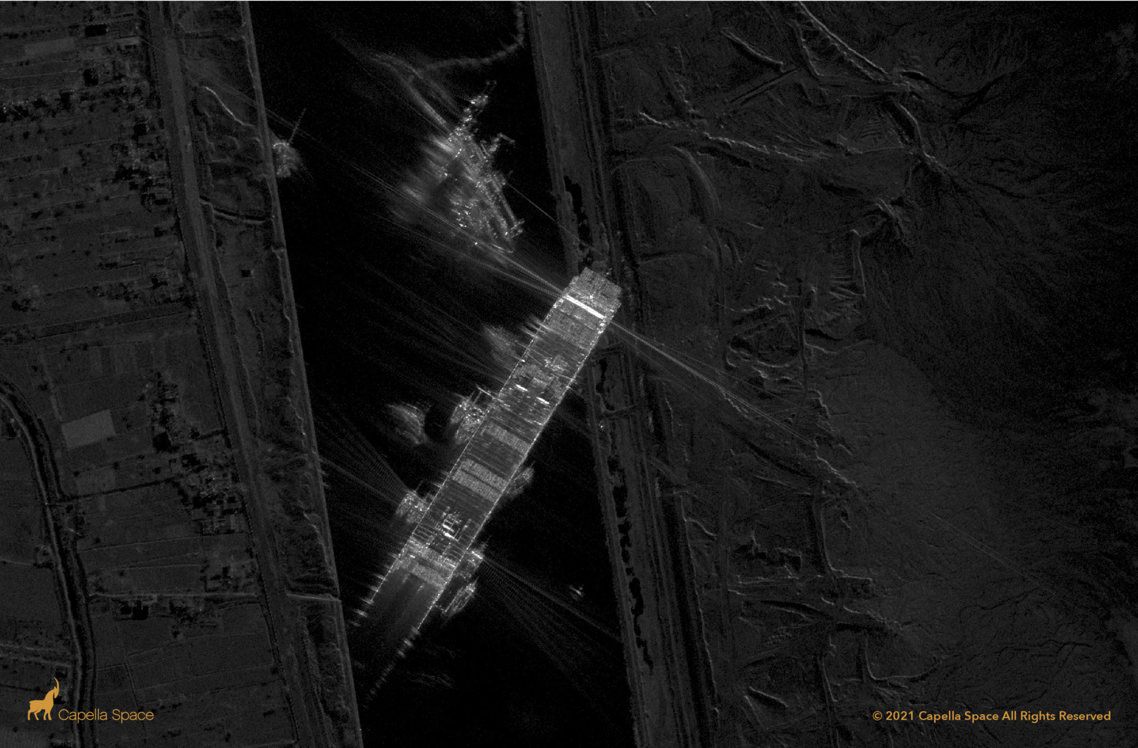

Slide 16
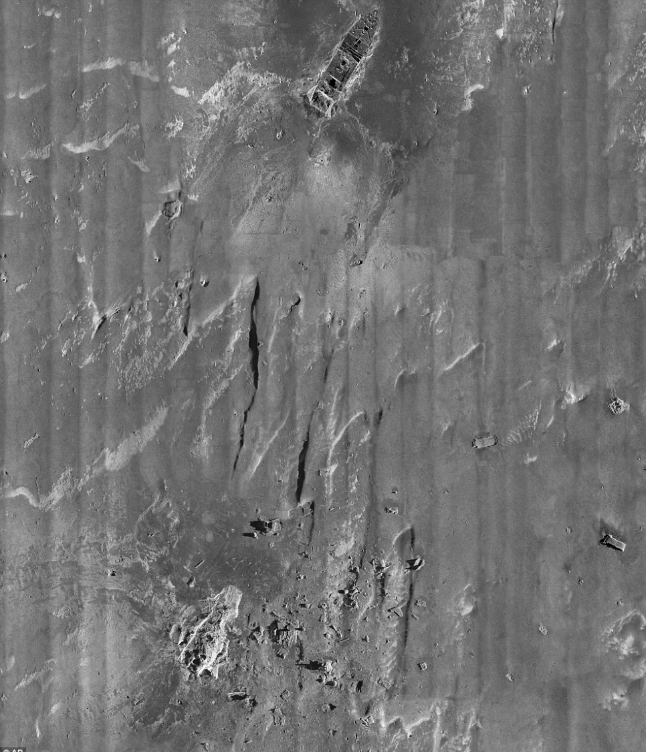

Slide 17
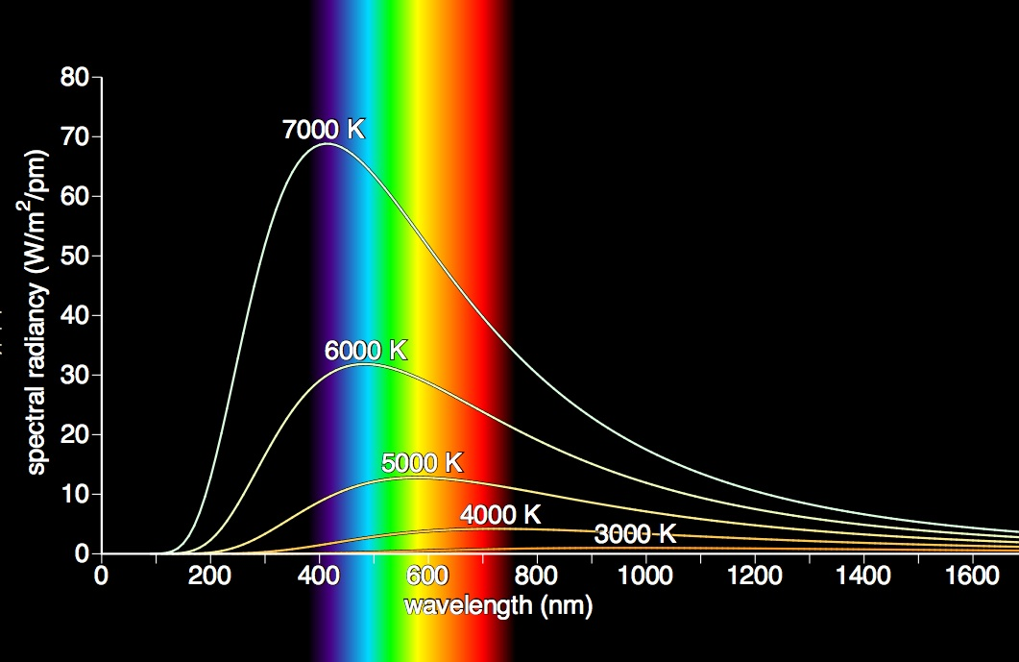
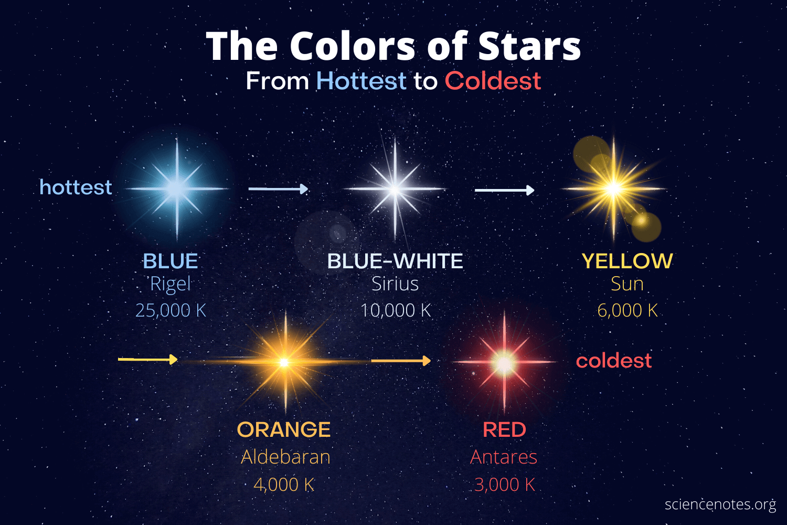
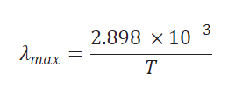

UV
Visible
Infrared
$$λ=\frac{c}{f}$$

Slide 18
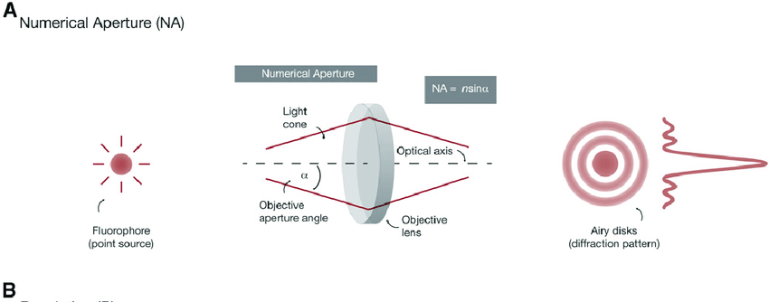

Slide 19
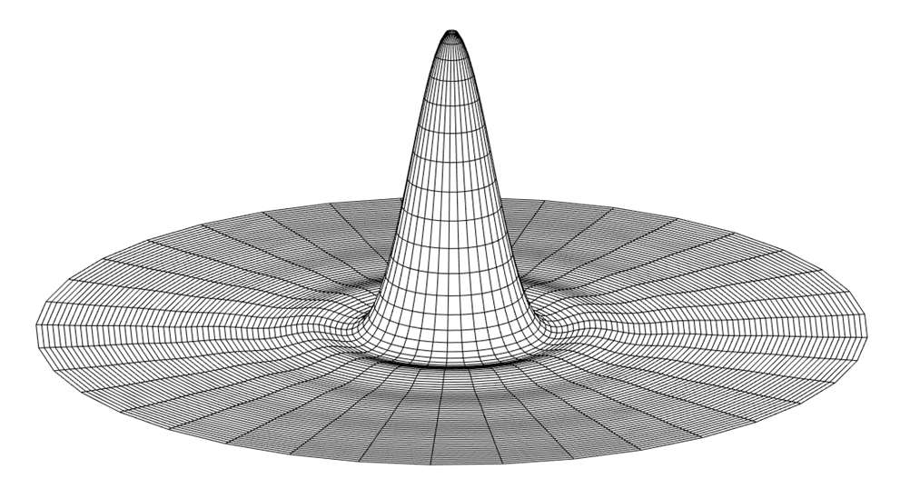
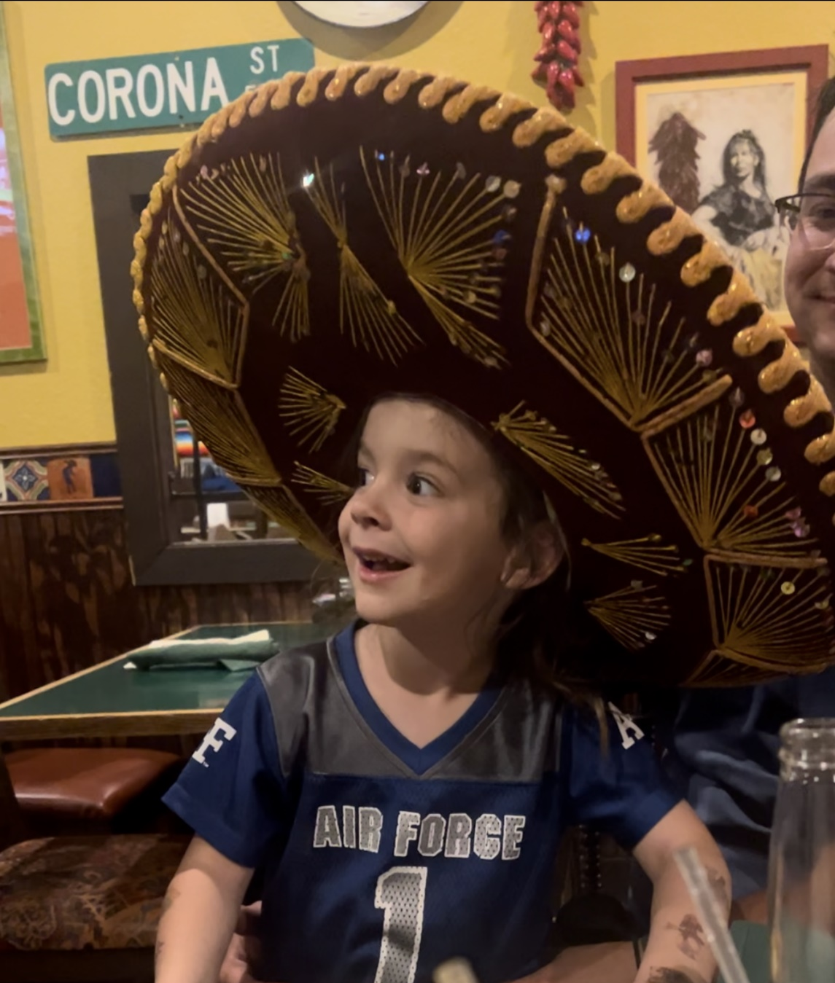

Slide 20
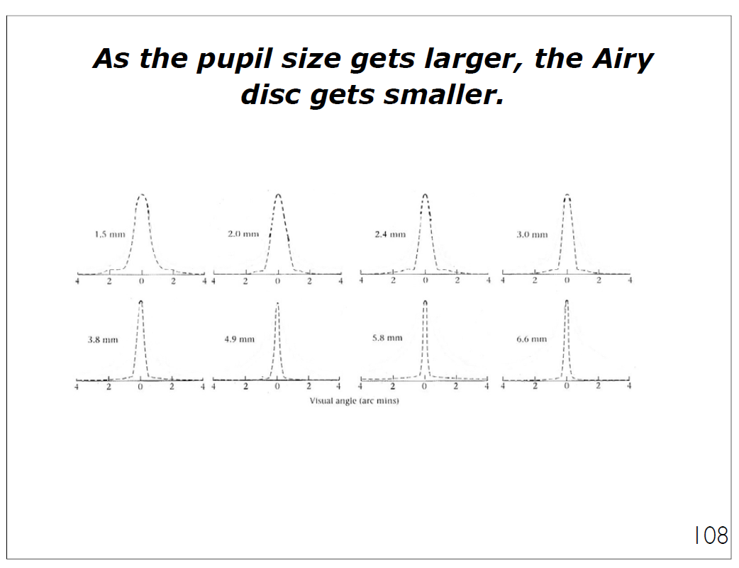

Slide 21
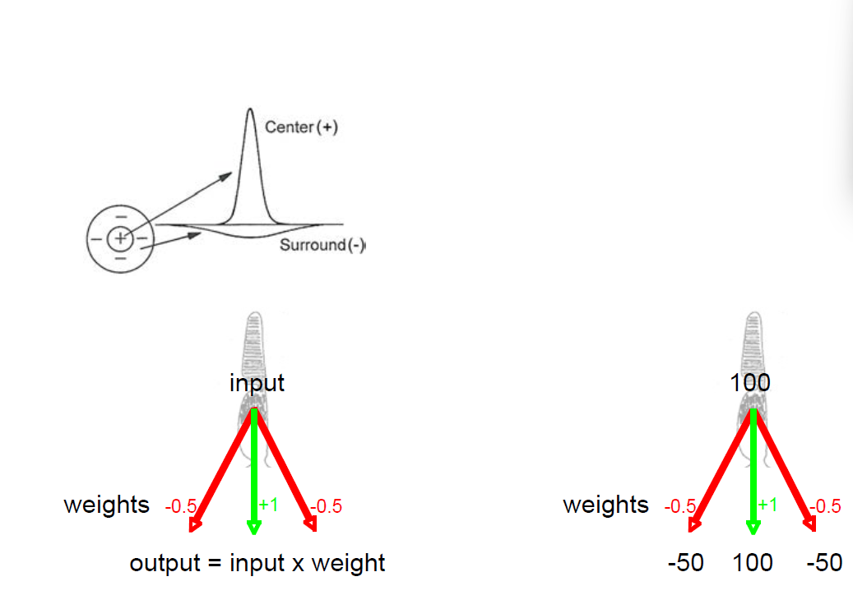

Slide 22
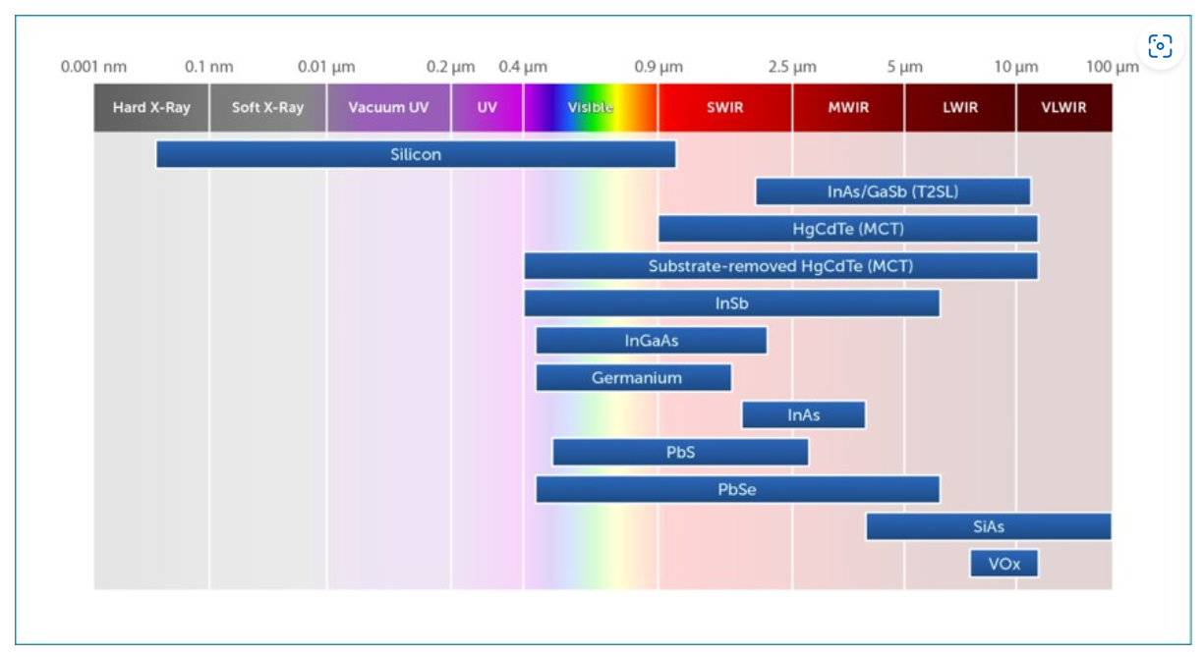
Sensors

Slide 23
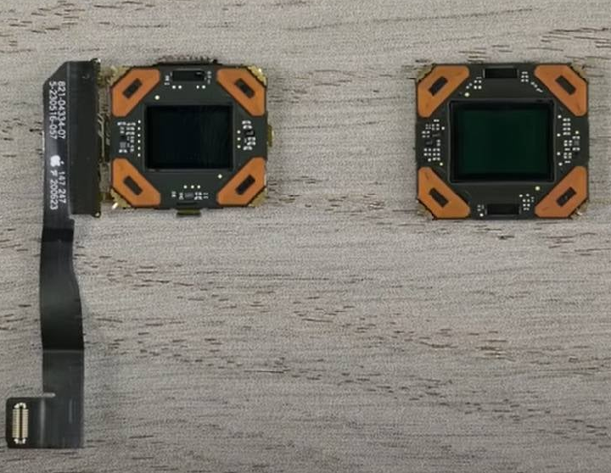
Sensors

Slide 24
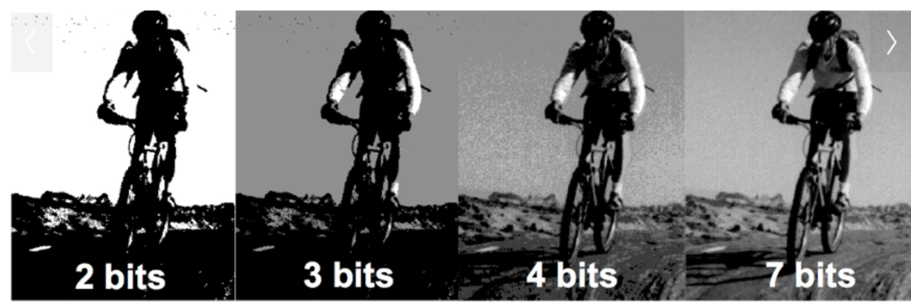
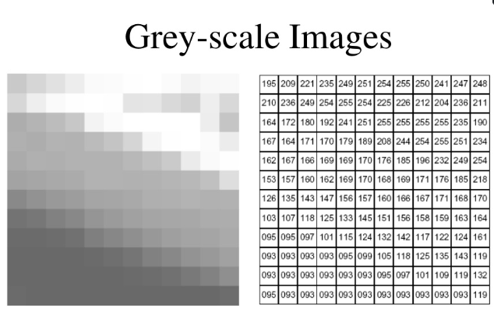

Slide 25
Resolution
The smallest interval measurable by a scientific (especially optical) instrument; the resolving power.
The degree of detail visible in a photographic or television image.
"a high-resolution monitor“
The act, process, or capability of distinguishing between two separate but adjacent objects or sources of light or between two nearly equal wavelengths.

Slide 26
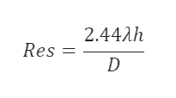
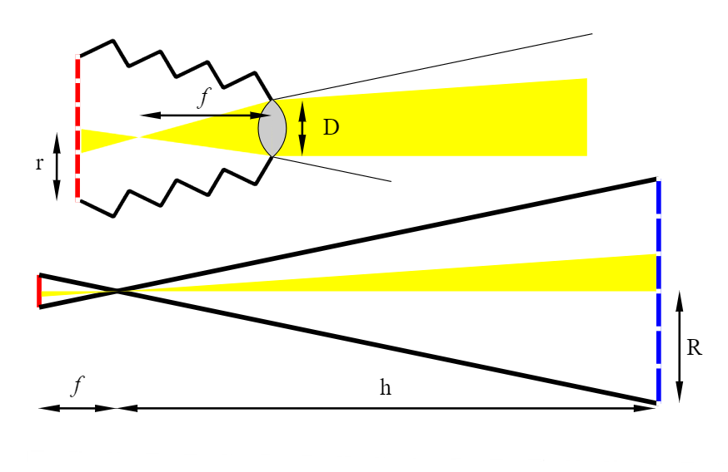

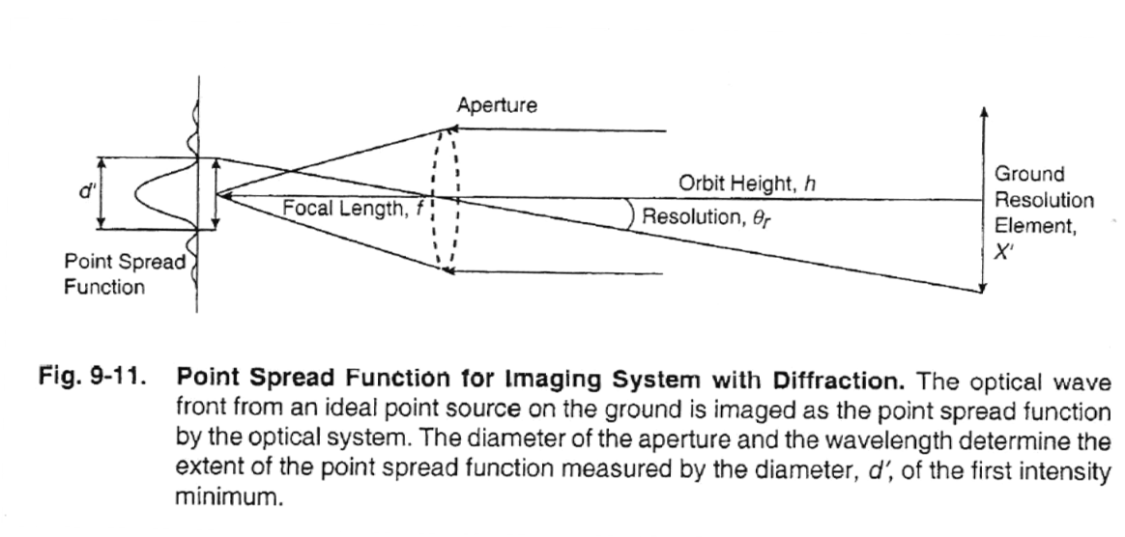


Resolution
$$R= \frac{r_{d}h}{f}$$
$$mag= \frac{f}{h}=\frac{r}{R}$$

Slide 27
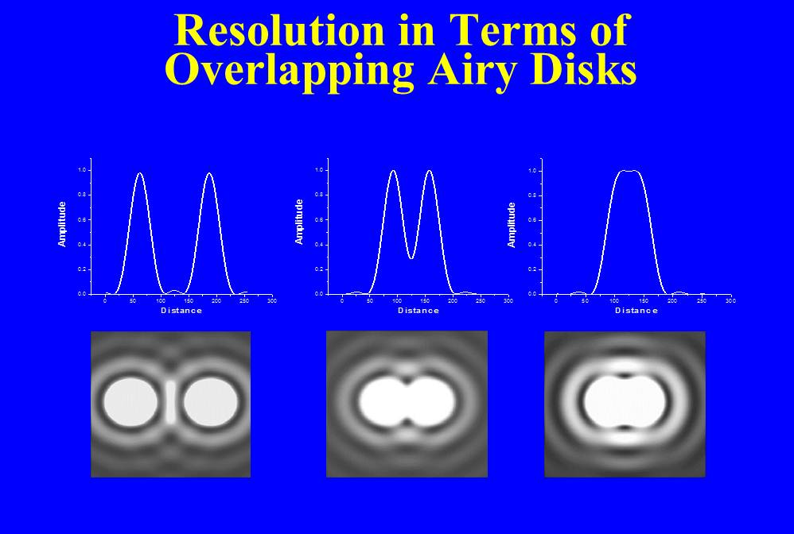

Slide 28
Types of Resolution
Spatial
Spectral
Temporal

Slide 29
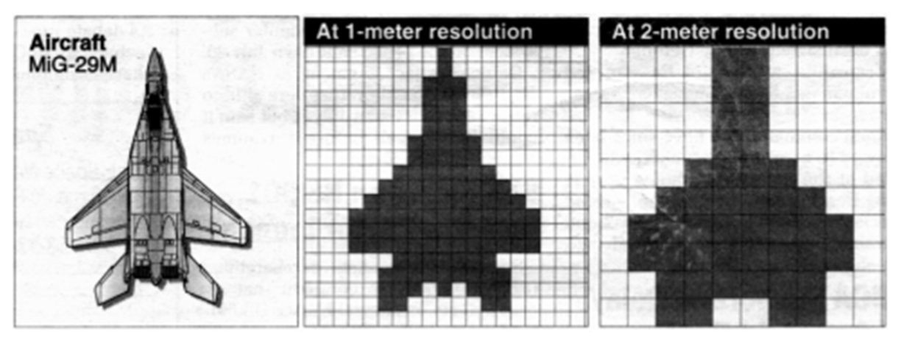
Spatial

Slide 30
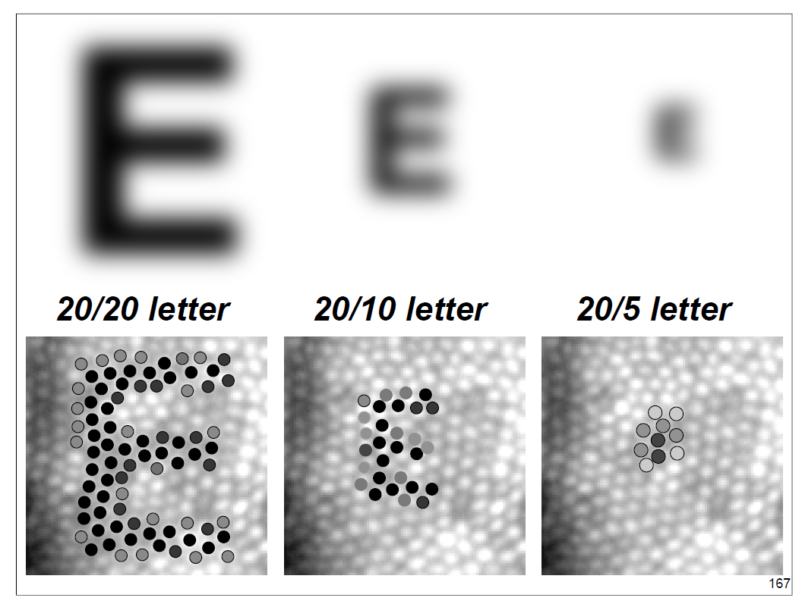

Slide 31
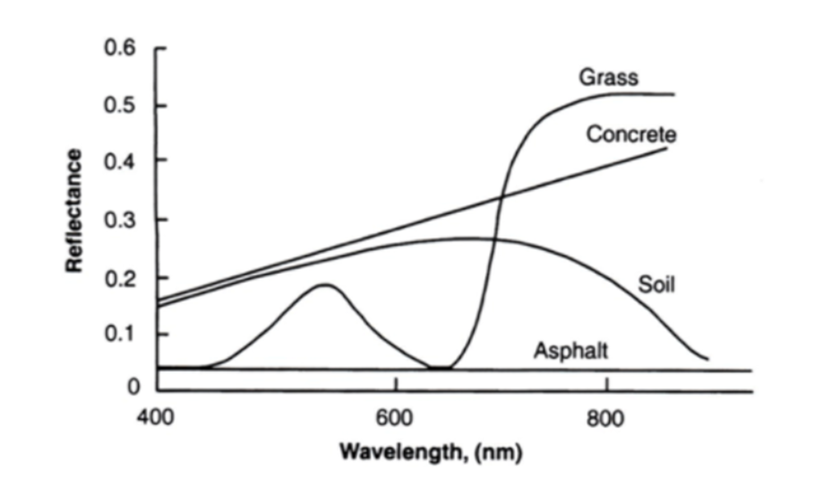
Spectral

Slide 32
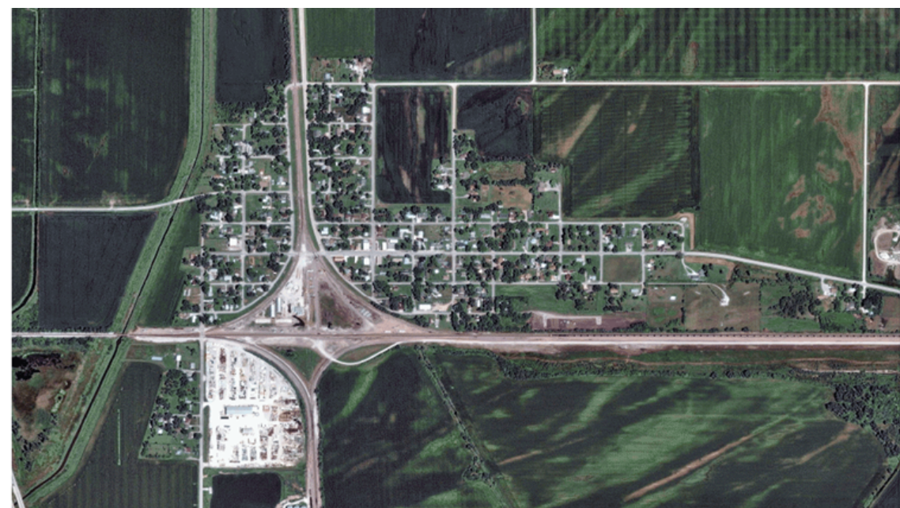
Temporal

Slide 33
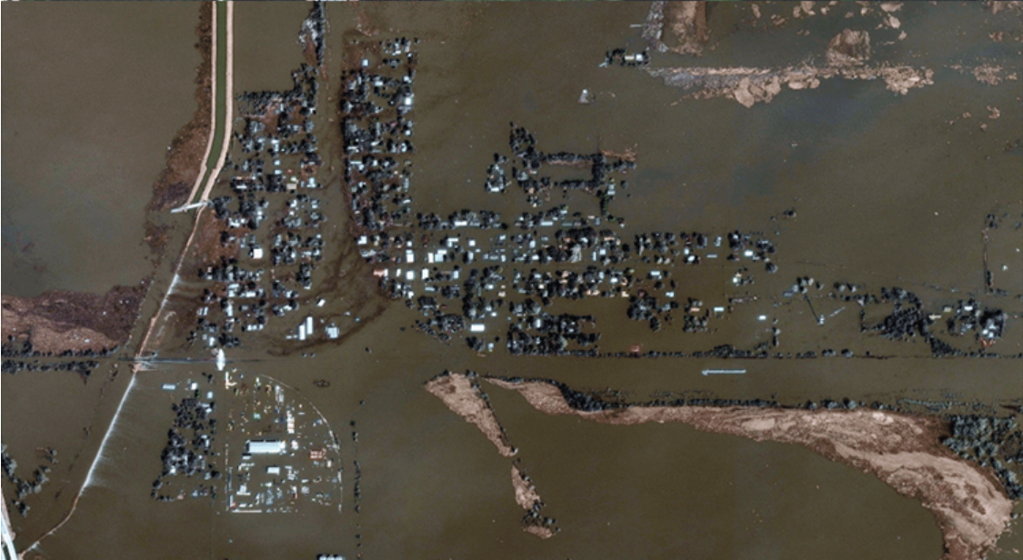
Temporal

Slide 34
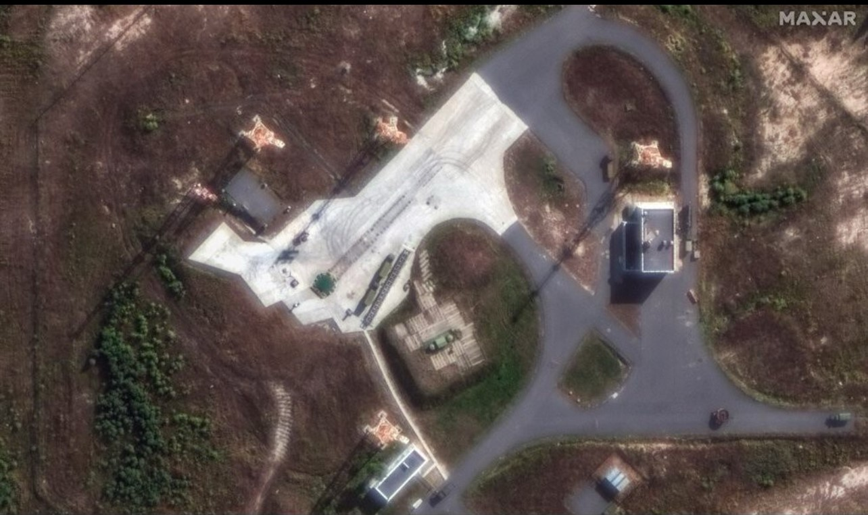

Slide 35
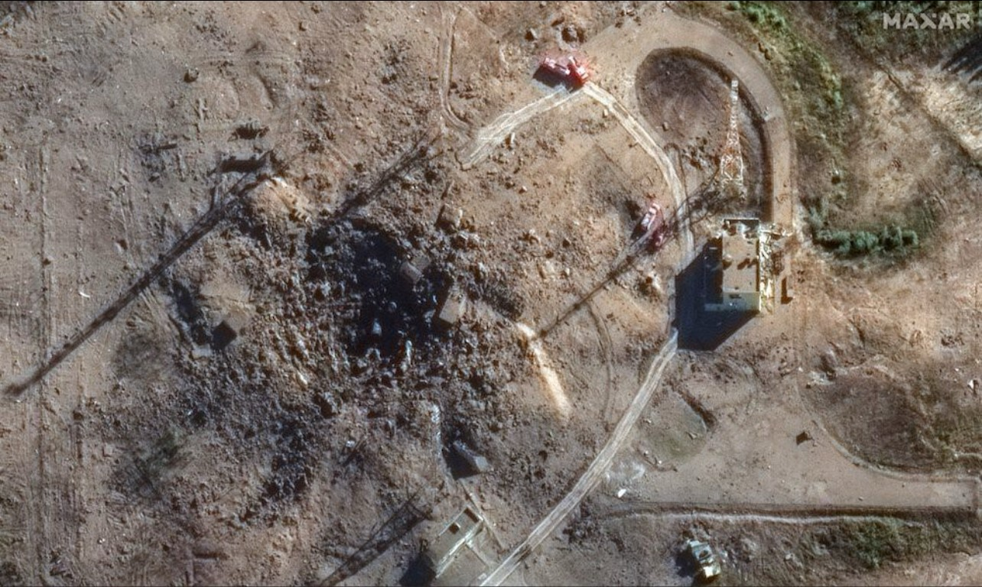

Slide 36
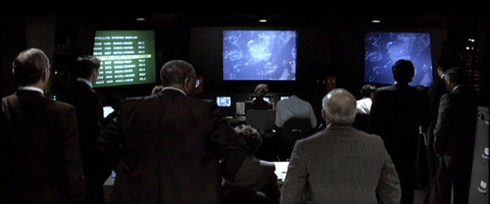
Patriot Games Fact or Fiction?
Res =
λ =
D =
h =
6 in (15 cm)
10 μm (near IR)
2.4 m (Hubble mirror size)
?

